Slide 1
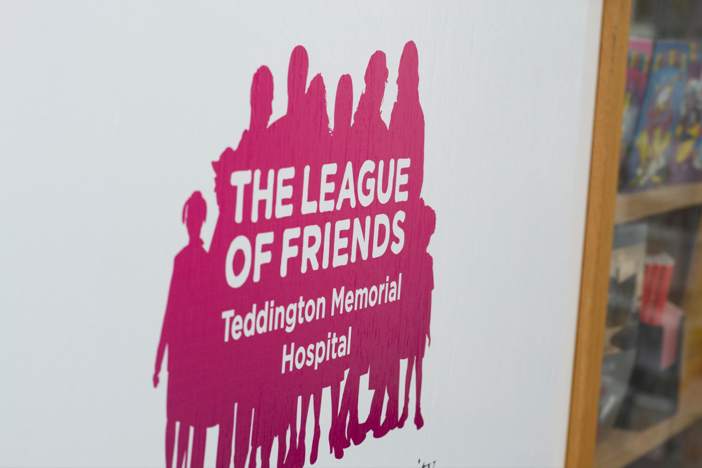
Anne Stratton
Chief Operating Officer, HRCH

Slide 2
Agenda
Thank you to the Friends from all of us at HRCH – some highlights
Current position in the Trust
HRCH working with our partners at Your Healthcare and Kingston Hospital

Slide 3
Notes:
I wanted to start this presentation with a big thank you. The League of Friends is an essential part of the community supporting staff and patients of Teddington Memorial Hospital by enabling and enhancing the quality and quantity of the provision of medical services, facilities and general improvements above the NHS funded baseline, you support ensuring the long-term future of the hospital. HRCH feels entwinned with you and always will.

Slide 4
HRCH and TMH – Working together
Recently funded
Medicarts
ECG -acute care analyser
Dermatoscope
Notes:
I started to list all the things that you had supported us with over the years and it was a long list and the range is amazing, you have helped our staff to deliver the best care they can. I haven’t included everything, but rather the things that have stuck with me. That does not mean we don’t appreciate everything you support us with, just says more about my memory! Let me tell you about some of the things you have funded. Firstly Medicarts to help staff on the ward get around the ward quicker and in more efficient way, you have also funded an ECG -acute care analyser, and Dermatoscope, these allow UTC and outpatient staff to diagnose and treat patients more effectively and quickly as we don’t have to refer these patients elsewhere for further test and we can let them know more quickly about the issue they came to see us about

Slide 5
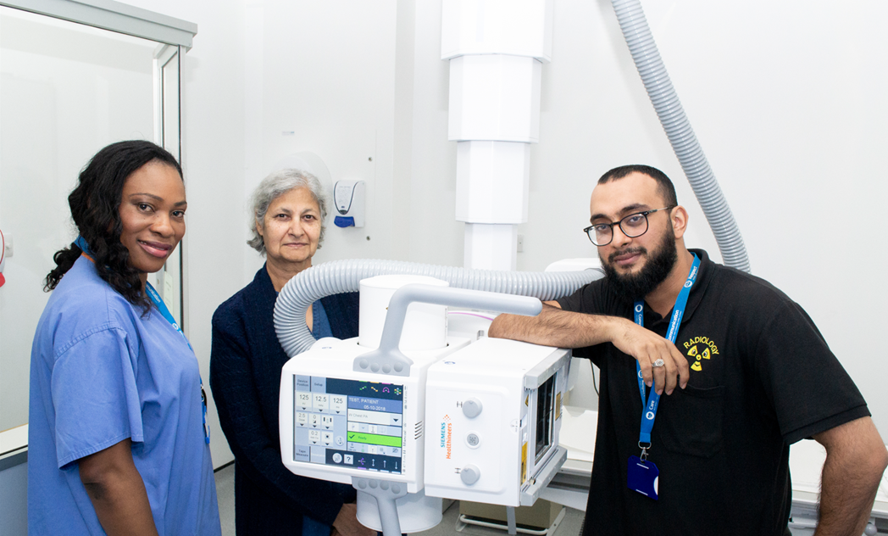
New x-ray facilities funded by the Friends
Notes:
Vital state of the art equipment, has further enhanced the type of treatment that patients receive.

Slide 6
Munira Wilson opening the new paediatric audiology room
Notes:
And who can forget the recent opening of the new paediatric audiology room, you may recognised some of the people in the photograph. The Friends of Teddington Memorial Hospital has always helped us to keep at the front of technology and to help us to rise to the needs of patients. This year we saw the opening of a second paediatric audiology screening room at TMH on 13 June. More local children with hearing problems will now get the care they need quickly and HRCH can deliver this in a way that meets the best standards in the country

Slide 7
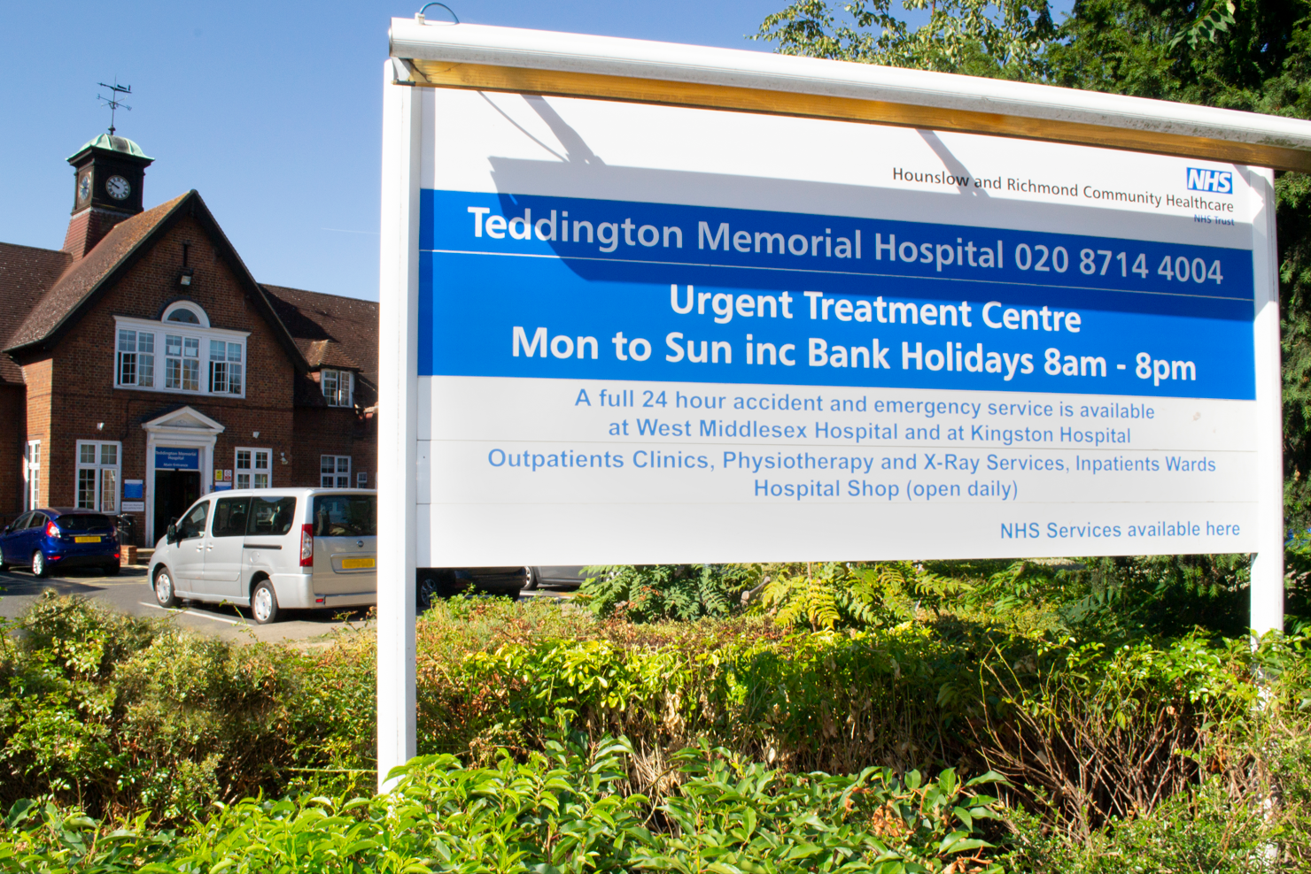
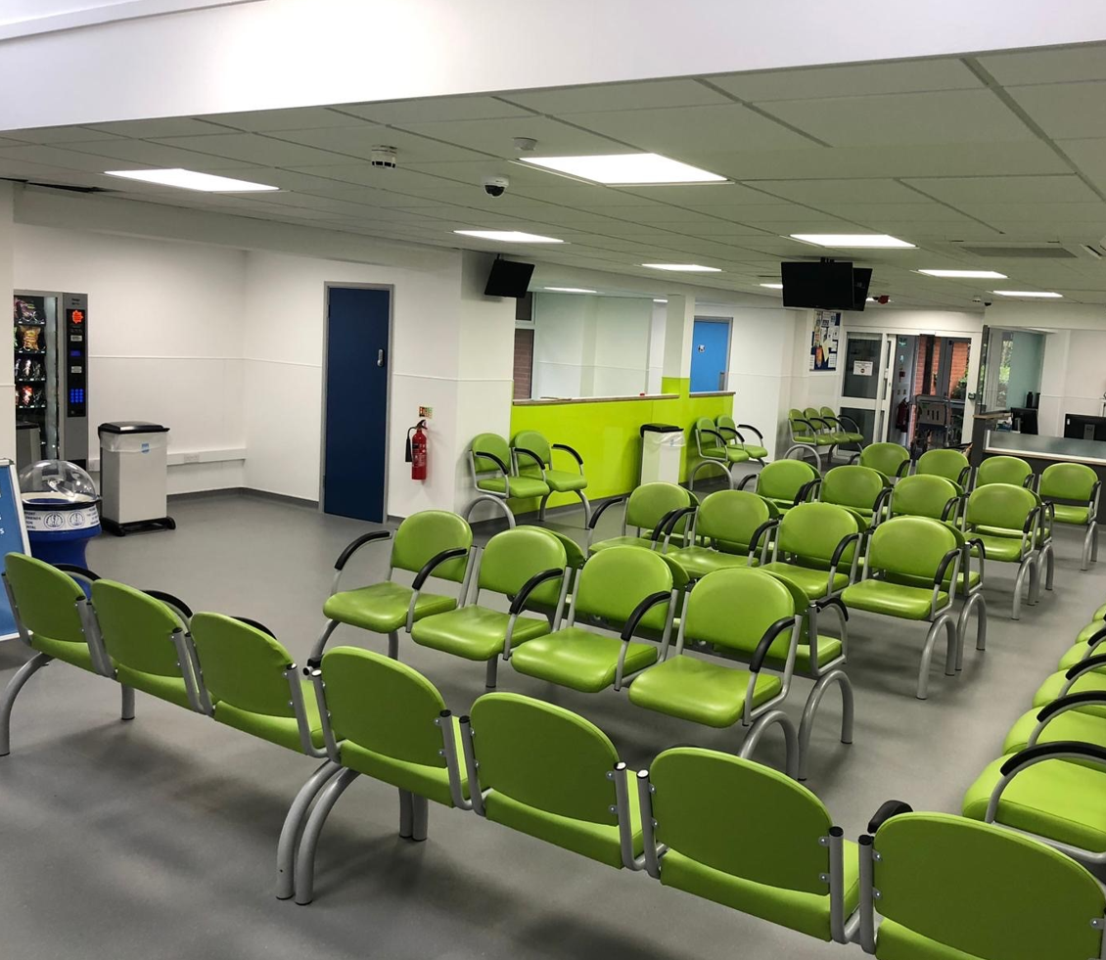
UCC waiting room refurbishments
Notes:
The League of Friends are always there at the forefront of improving our environment, understanding how important that is to both staff and patients. This can be seen in the redesign and refurbishment of the UCC reception area at TMH, where the reception was developed with a lower counter for wheelchair users and better acoustics to ensure improved patient confidentiality and the bespoke children’s play area to occupy children and sometimes their parents

Slide 8
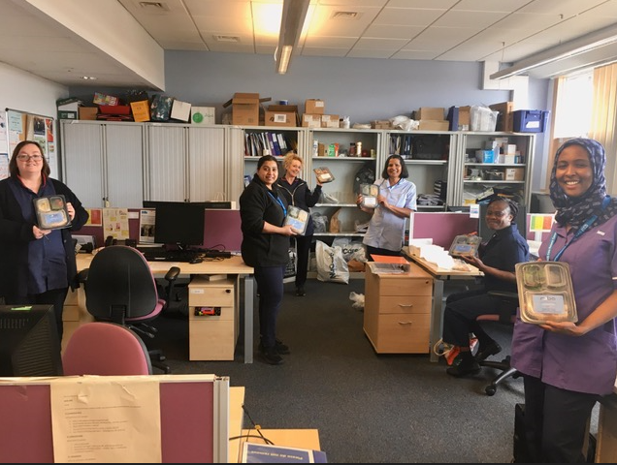
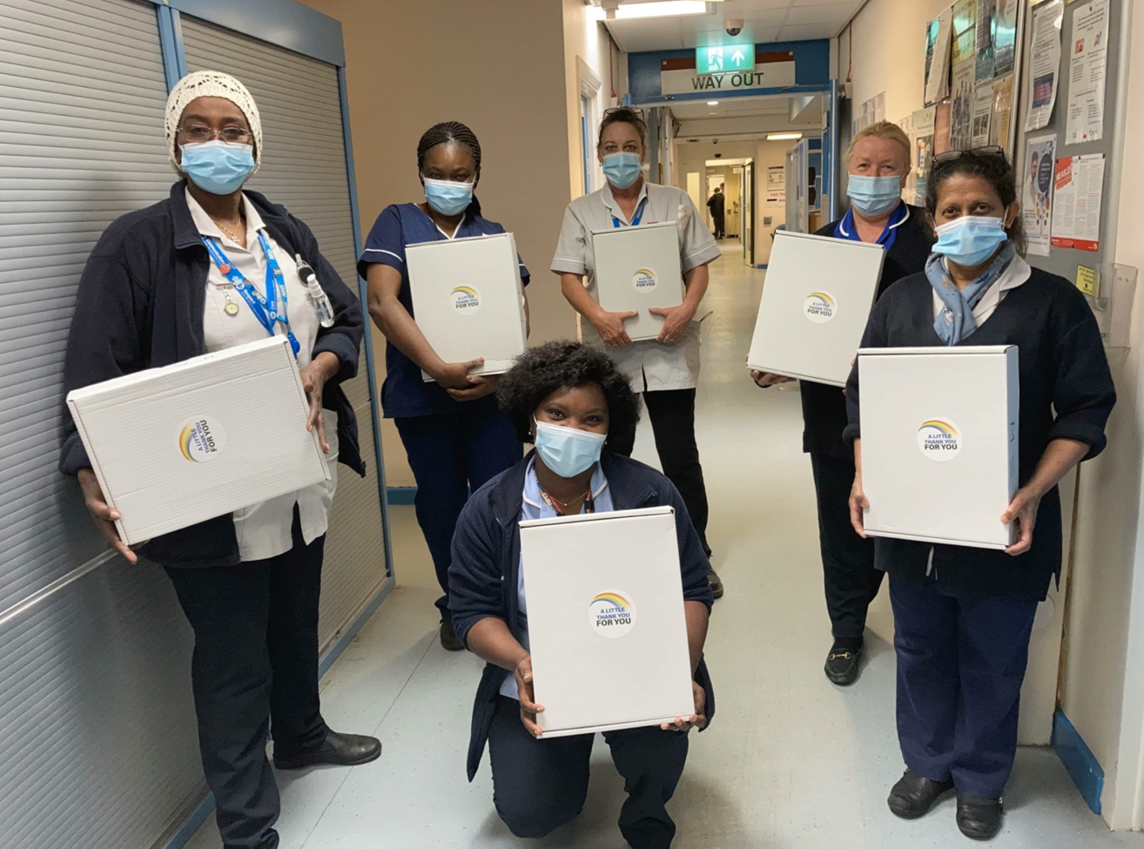
Gift boxes / food donations for staff
Notes:
However what has meant the most to our staff in recent years has the way the league of Friends has stood by us during the toughest of times. At the height of the pandemic you were there supporting them, co-ordinating meals to keep them sustained when they were at their busiest. This made staff feel valued when they were sometimes at their lowest ebb. The support you also gave in helping us put together the thank you packs for our staff was really appreciated.

Slide 9
HRCH and TMH – Working together
What next
Improved relatives room
Improvement to the garden
Point of Care testing for our RRRT service
Notes:
Simon and Trustees are always looking at ways to support the hospital and staff and keep me on my toes at our regular meetings. A few of the ideas we are considering at the moment are:
A relatives room – trying to find the space is not easy but nearly there
Improvements to the garden so the space is better for patients and staff
Point of Care testing – this is to support the work of our RRRT service based at TMH, this service is responsible for patients who need rehabilitation at home but it is also the team responsible for a two hour response to ensure that we get to patients quickly and treat them at the place they usually live and where appropriate to keep them at home with support rather than be admitted to an acute hospital. This team are also piloting work with the London Ambulance service (LAS), where we will have a team member share a car with the LAS to respond to emergencies and keep as many people at home rather than being conveyed by an ambulance to hospital.

Slide 10
Anne Stratton and the League of Friends
Joined as TMH manager in 1999, at that time the smallest trust in the country
Interview panel included Pamela Bryant
Always had a clear history of how importance of the League of Friends and their commitment to the hospital
Pleased to be back again working with the League of friends in my new role
Notes:
I have also had very person experience of the League of Friends.

Slide 11
How is HRCH and TMH doing Staff survey… great place to work
Best trust in London for compassionate culture, having a voice that counts, staff engagement and working as a team.
Best community trust nationally for having a voice that counts and staff engagement
2nd among community trust nationally for recommending the trust as a place to work
Patient care is the trust’s top priority.
Notes:
I just wanted to give you an idea of where HRCH is at the moment with some of our highlights and our challenges. Staff like working at HRCH and we are really proud of that.

Slide 12
Recruitment and Retention of staff Staff turnover – a challenge
Notes:
However even though staff like working for us we, as are many organisations health or otherwise, are struggling to find and retain staff. Staff turnover has been a significant challenge for the Trust, ending the year at 17.8% turnover, against the 14.5% target. During the year we have seen colleagues making life choices moving out of London, taking early retirement and leaving the NHS. We have had to work hard to retain staff and to recruit new staff into the organisation, including recruiting more international nurses this year. The key areas of challenge are in community nursing and Allied Heath Professionals (AHPS), this includes staff such as physios and OTs.
However, we have recently strengthened our recruitment activities by joining the SWL Recruitment Hub. I am pleased to report that we are now seeing the early signs of our turnover rates levelling off.

Slide 13
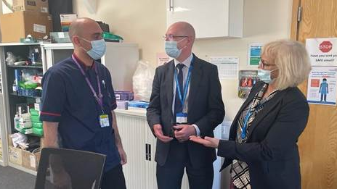
Moving beyond the pandemic
Notes:
Recently, we have engaged with staff through our work to support them to Move Beyond the Pandemic, to ensure the actions we are taking are the right ones.
Health and wellbeing (more recent challenges of the cost of living)
New ways of working
Enabling and supporting leaders to lead
Staff communications and engagement

Slide 14
Notes:
Some of our teams have had an opportunity to take part in away days to help them reconnect and plan ahead. We have asked them to have fun as well as doing work.
We continue to promote apprenticeships in the trust, offering more clinical apprenticeship opportunities, and now have 16 apprentices across the trust, including 3 staff undertaking masters degrees.

Slide 15
Your Healthcare Partnership: 5 key areas
Long COVID
Equality, diversity and inclusion
Urgent and emergency care: sustaining flow
Digital
Virtual ward
Notes:
Our relationship with Kingston Hospital is not the only partnership that is developing. HRCH are working more closely with Your Health care, with HRCH as the lead contractor. This helps strengthen the voice of community and allows us to share ideas and developments. We have agreed 5 areas (also called pillars or workstreams): Long COVID, Digital, virtual ward, equality, diversity and inclusion and urgent and emergency care

Slide 16
Better together
Taking forward collaborative working
+
Hounslow and Richmond Community Healthcare NHS Trust
Kingston Hospital NHS Foundation Trust
Your Healthcare
+
+
Notes:
Nationally, and across London in particular, changes are happening to join up care within integrated care systems – and so at a local level we are joining up with Kingston hospital to secure our future and to ensure that we are doing all we can to join up care locally and ensure that we focus on providing care in the community for local people.

Slide 17
Notes:
We remain as separate organisations, with separate boards, but one leadership team across the two – which is facilitating much closer working across the two organisations. As of 01 April, we have had a shared leadership team across HRCH and Kingston Hospital FT. There are two Chief Operating officers operating as part of the single executive team. One for community, me and one for the acute Trust, she is not on our board of directors.
.

Slide 18
Current areas of focus
Workforce
Health and wellbeing, recruitment and retention
Urgent and emergency care
Flow
Elective recovery (including outpatients)
Supporting the acute with their elective work, but also worth noting community services has waiting list too
Finances

Slide 19
Thank you for your continued support

